Slide 1
DIGITAL PORTFOLIO
STUDENT NAME: LOKESH V
REGISTER NO AND NMID: 212400951 / D877702226EA197B3D84EF16C913523A
DEPARTMENT: BCA
COLLEGE: PRINCE SHRI VENKATESWARA ARTS AND SCIENCE COLLEGE

Slide 2
PROJECT TITLE
Digital portfolio

Slide 3
AGENDA
1.Problem Statement
2.Project Overview
3.End Users
4.Tools and Technologies
5.Portfolio design and Layout
6.Features and Functionality
7.Results and Screenshots
8.Conclusion
9.Github Link

Slide 4
PROBLEM STATEMENT
In today’s competitive digital world, students and developers need a personal platform to showcase their skills, projects, and achievements. Traditional resumes often fail to demonstrate practical abilities and creativity.
I

Slide 5
PROJECT OVERVIEW
This project is a personal portfolio website for Lokesh.V, a BCA student and aspiring web developer.
The portfolio is designed to highlight:
*Personal details and introduction
*Skills in programming and web development
*Projects completed
*Contact information and professional links (Email, LinkedIn, GitHub)

Slide 6
WHO ARE THE END USERS?
The main users of this portfolio website are:
1. Recruiters & Employers – To evaluate skills and contact for job/internship opportunities.
2. Peers & Collaborators – For project collaboration and networking.
3. Faculty / Academic Institutions – To assess learning progress and technical ability.

Slide 7
TOOLS AND TECHNIQUES
*HTML5 – For website structure
*CSS3 – For styling and layout (yellow & black theme, responsive design)
*JavaScript – For interactivity and smooth navigation
*GitHub – For hosting code and version control
*LinkedIn – For professional networking integration

Slide 8
PORTFOLIO DESIGN AND LAYOUT
Navigation Bar – Links to About, Skills, Projects, and Contact sections
✅ Hero Section – Name, role, and short description displayed with a yellow header
✅ About Me Section – Introduction and personal statement
✅ Skills Section – Programming & Web development skills with progress bars

Slide 9
FEATURES AND FUNCTIONALITY
* Code Reader: Converts code to human-friendly spoken descriptions
* Smart Navigation: Lets users jump between functions, variables, and classes
* Error Detection: Reads out syntax errors and warnings with suggestions
* Customization: Adjust voice speed, pitch, verbosity, and language

Slide 10
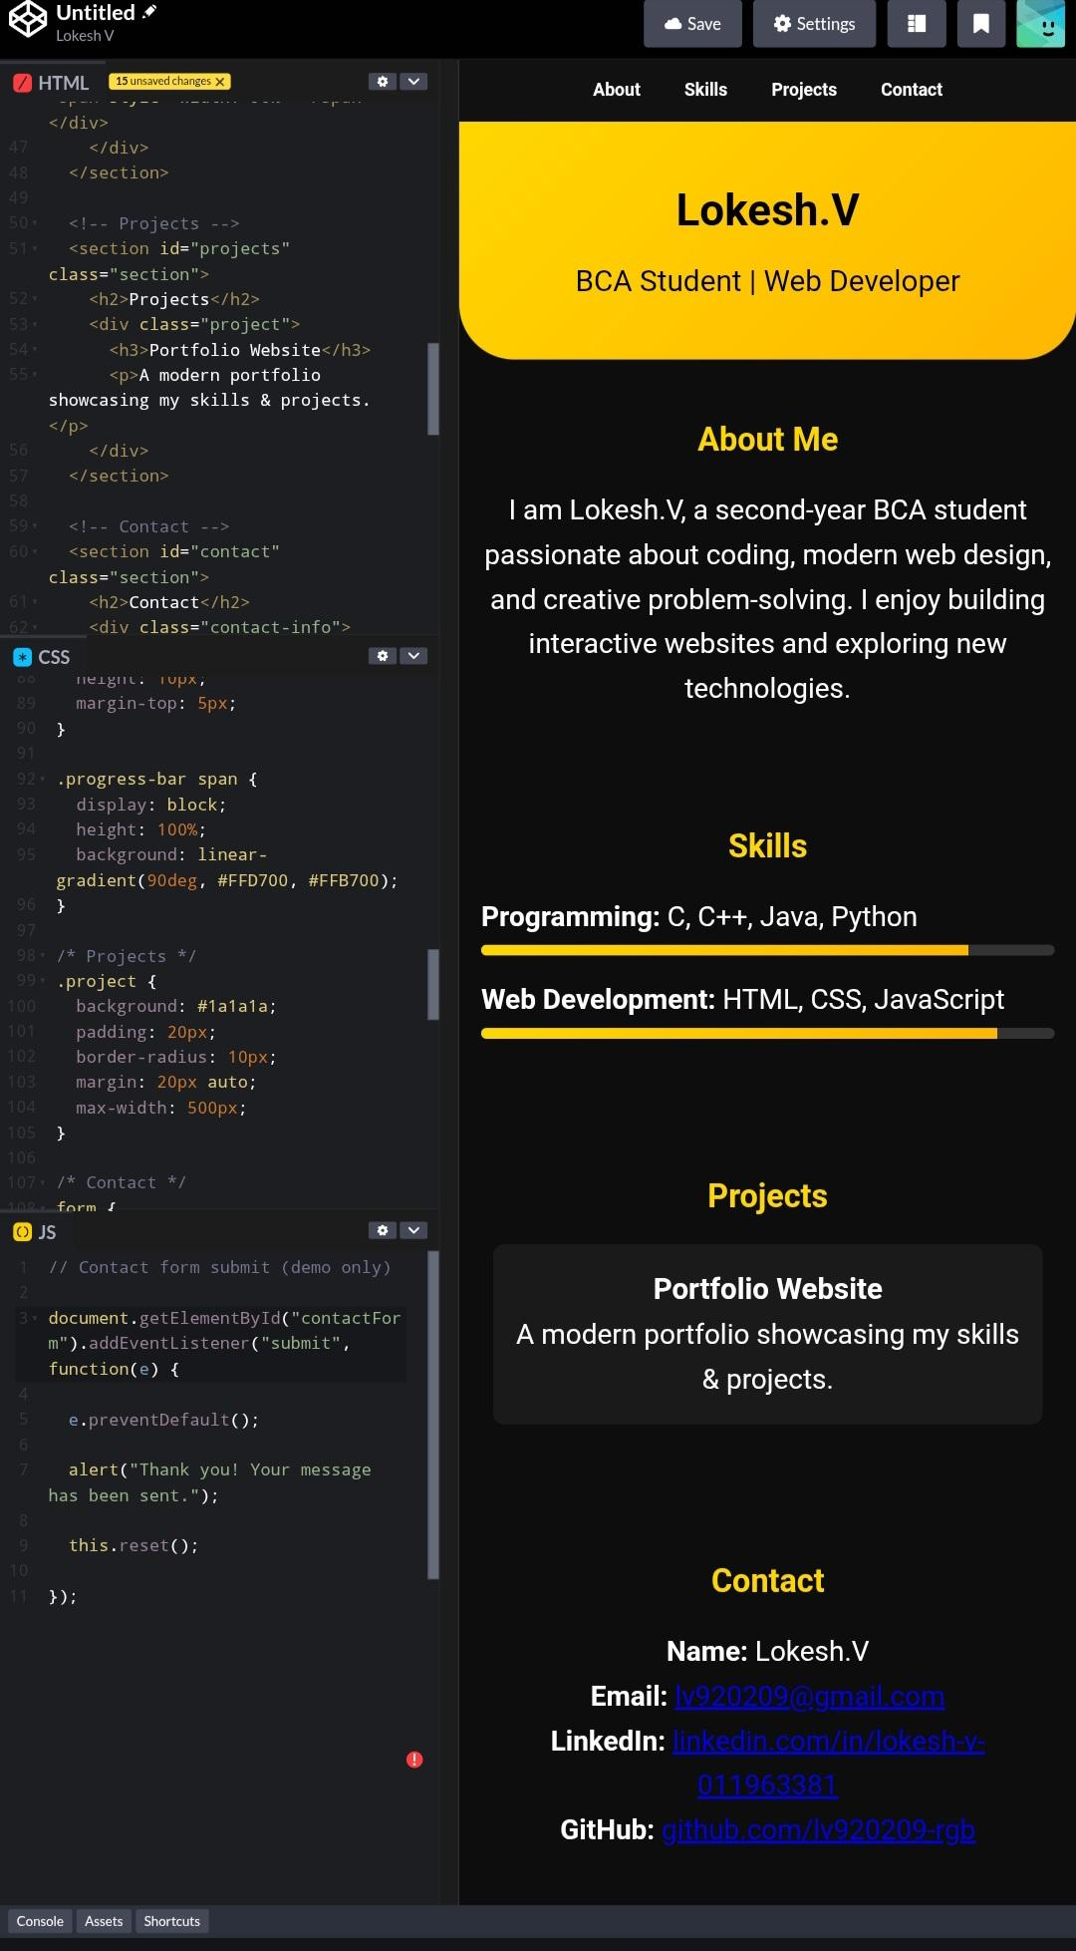
RESULTS AND SCREENSHOTS

Slide 11
CONCLUSIONS
The personal portfolio website is an effective solution for representing skills and projects in a digital format. It addresses the limitations of traditional resumes by providing an interactive platform that is easily accessible to recruiters and collaborators. With further improvements (like adding more projects, blogs, or certifications), it can become a powerful personal branding tool for career growth.
The

Slide 12
GitHub link:
https://lv920209-rgb.github.io/TNSDC-FWD-DP-lokesh/

